Slide 1
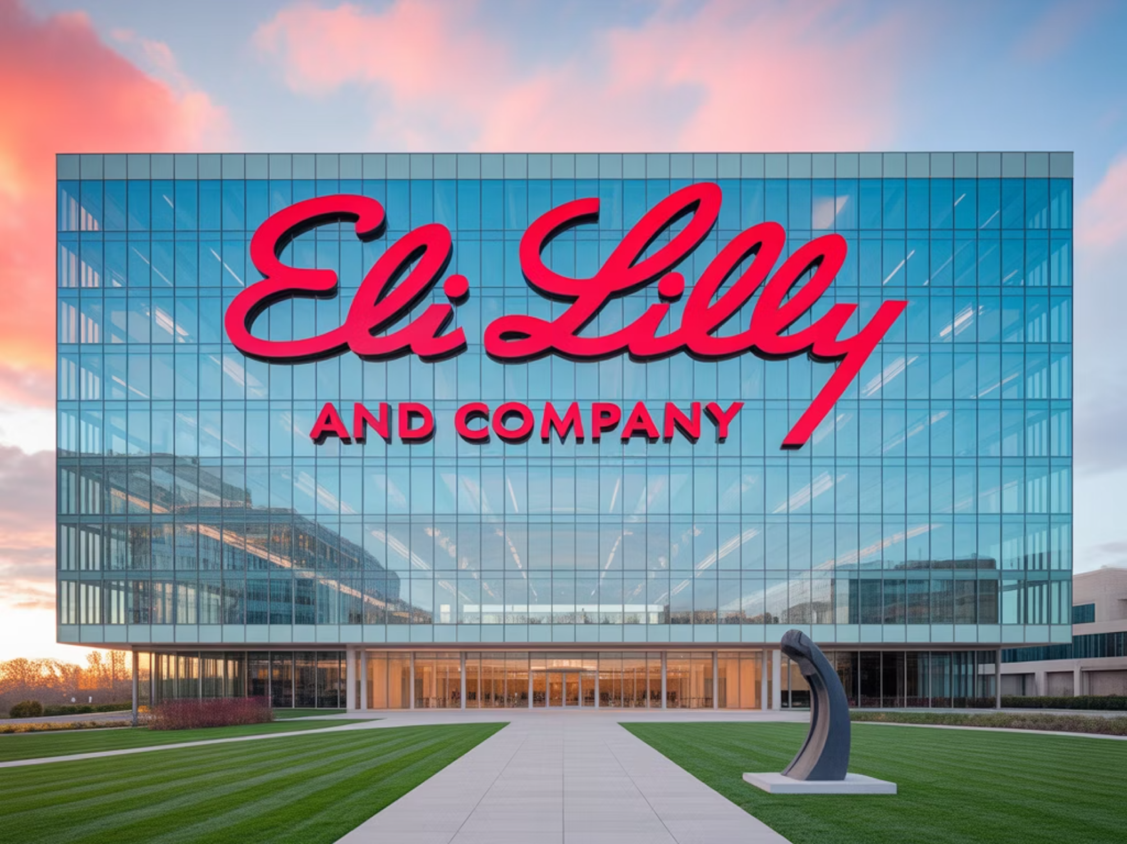
Company Overview: Eli Lilly & Co
Eli Lilly, founded in Indianapolis in 1876, is a global pharmaceutical leader with:
Presence in over 120 countries
Annual revenue exceeding £28 billion
Focus on diabetes, oncology, neuroscience and immunology
Their mission, "to make life better for people around the world," underpins their strategic digital transformation programme.

Slide 2
Digital transformation journey
Manufacturing Transformation
Innovation & Patient Care
Aimed to boost efficiency, quality assurance, and real-time decision-making, while reducing risks. This involved leveraging technologies such as:
Lilly extended its digital efforts to enhance core business areas, focusing on:
Leveraging AI for accelerated drug discovery
Robotics
Launching LillyDirect, a direct-to-patient platform for chronic conditions
IoT sensors
AI for predictive maintenance
These initiatives underscored their commitment to innovation and improving patient access and care.
Advanced data analytics
A flagship project, the Global Manufacturing Data Fabric (GMDF), connected all manufacturing sites for real-time visibility and quality monitoring.

Slide 3





Risks and Mitigation Strategies
Workforce Resistance to Automation
Legacy System Integration
Gradual introduction of robotics as safety tools fostered employee acceptance and smooth integration.
Adaptable GMDF interfaces connected existing systems, ensuring seamless data exchange and unified visibility.
Regulatory Compliance
Cybersecurity Vulnerabilities
Robust governance and validation ensured new tech met GMP standards, maintaining full regulatory compliance and quality.
Comprehensive IT/OT security and continuous monitoring protected data and operations from cyber threats, ensuring continuity.
Data Privacy Concerns
Strong data management frameworks aligned with international privacy regulations
Preserved trust with patients, healthcare providers, and regulators

Slide 4
Change & People Management: Strategies and Impacts
Reinforcement & Integration
Implementation & Support
Assessment & Alignment
Assessed existing skills and aligned digital tools with patient outcomes.
Celebrated quick wins and embedded new digital practices.
Delivered targeted training programmes and robust support.

Slide 5
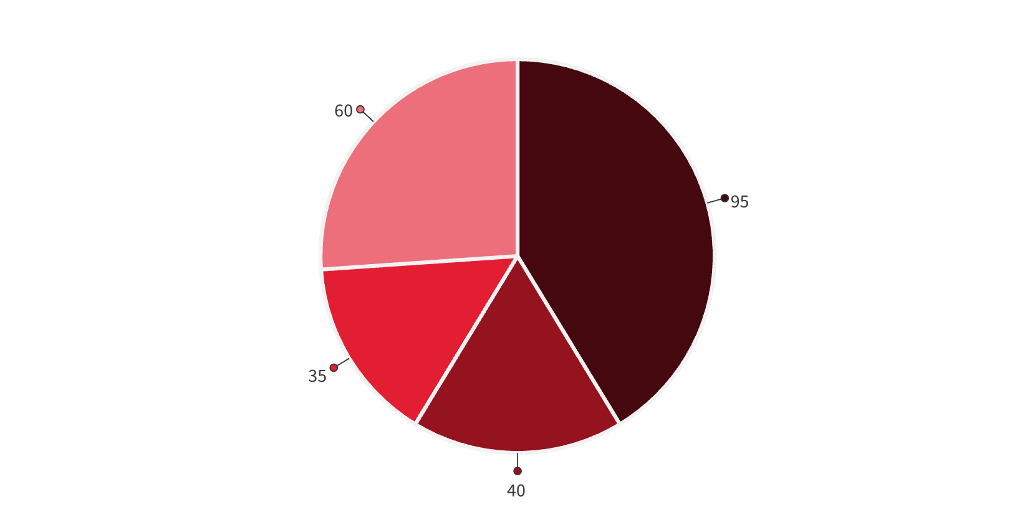
Research Insights
Manufacturing Excellence
Patient Care Innovation
The impact of Lilly’s transformation is measurable. At their North Carolina facility, automation reduced variability by 40%, prevented 95% of quality issues, and shortened batch release times by 60%. Flexible lines improved utilisation by 35%.
LillyDirect platform improved medication adherence by 32%
Reduced medication errors by 60%
Closed care gaps by 55%
Research & Development
AI partnerships cut drug development time by 30%
Reduced clinical trial completion time by 25%
Quality assurance systems at Irish site reduced recalls by 78%
Quality Issues
Variability
Line Utilisation
Batch Release

Slide 6
Key Lessons Learned
Purpose-Driven Transformation
Trust Through Communication
Compliance as Enabler
Maintaining regulatory excellence alongside digital progress showed that compliance can coexist with and even enable innovation.
Lilly's transformation succeeded by aligning technology with clear organisational goals, focusing on patient care and outcomes, not just innovation for its own sake.
Building trust via transparent communication, effective training, and employee involvement was crucial for adoption.

Slide 7



Conclusion: Final Thoughts and Recommendations
Eli Lilly's digital transformation journey highlights key principles for success. Profound change is achievable when anchored by clear purpose, championed by its people, and meticulously managed. Our recommendations for similar endeavours include:
Align Technology with Purpose
Empower and Engage People
Integrate Compliance and Innovation
Ensure all digital initiatives directly support core organisational missions, like patient care or scientific advancement, not just innovation for its own sake.
Prioritise human-centred change management, fostering trust through transparent communication, comprehensive training, and active workforce involvement.
Establish robust governance frameworks from the outset. Strict regulatory compliance can coexist with and enable digital progress.

